Slide 1

Recorder Festival Pieces
2023-2024

Slide 2
Have a go at any of the pieces. Don’t worry you find some difficult.
We will practice them back in school. Remember to bring your recorders in on Wednesdays.

Slide 3
In the Bag
Sing first time,
play the second and third time

Slide 4
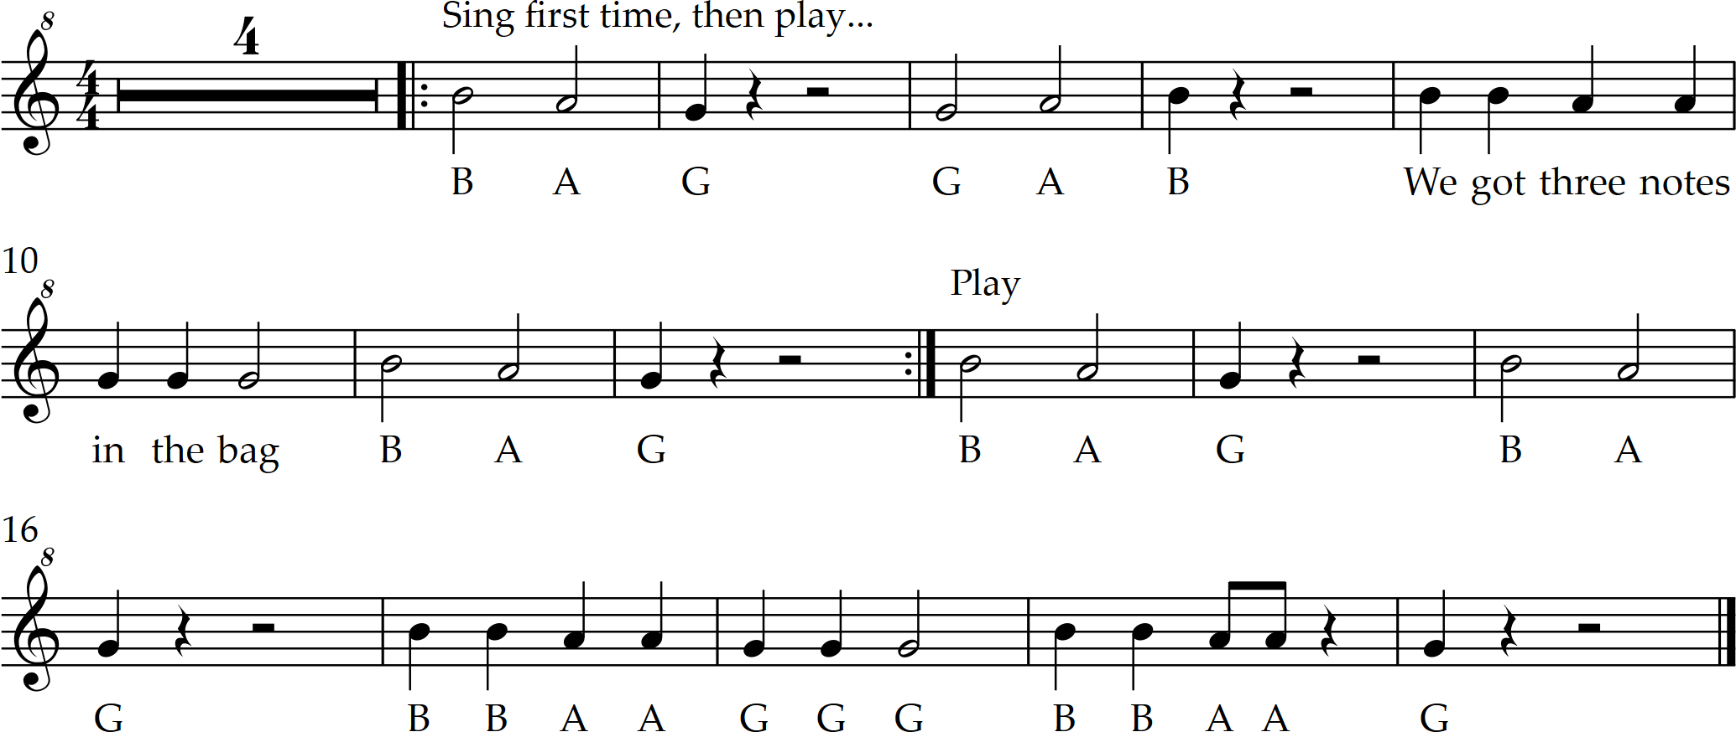

In the Bag! With notes
(4 bar intro)

Slide 5
Barefoot Boogie

Slide 6
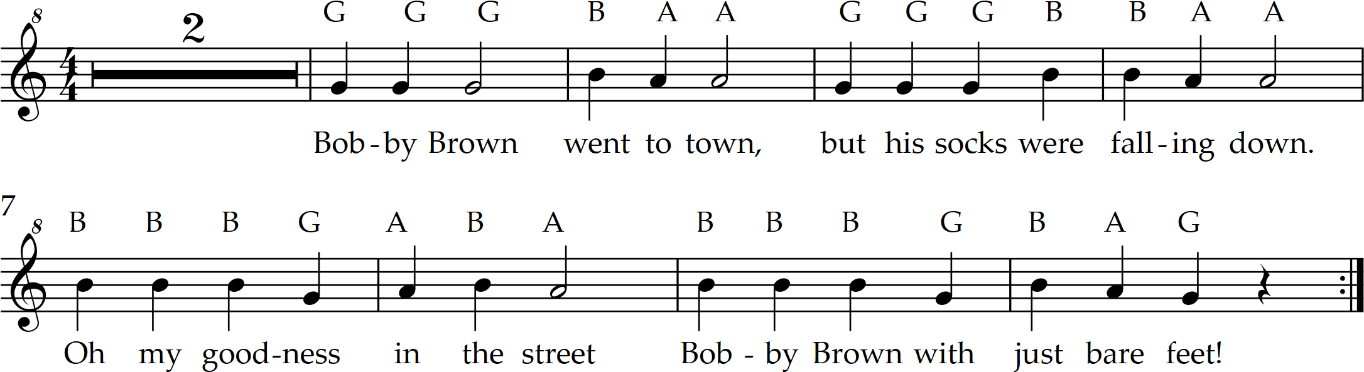
Barefoot Boogie with notes
(2 bar intro)

Slide 7
Recorder Blues
.

Slide 8
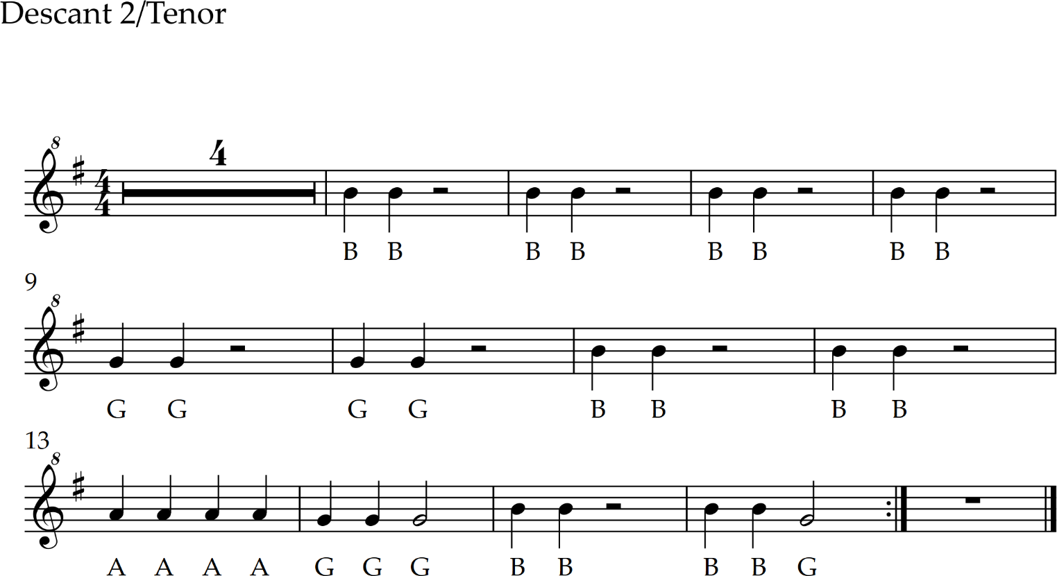
Recorder Blues Part 2 with notes

Slide 9
Mamma Mia
Remember to play the lower line that starts with G rest top hat. You join in at 57 seconds.

Slide 10
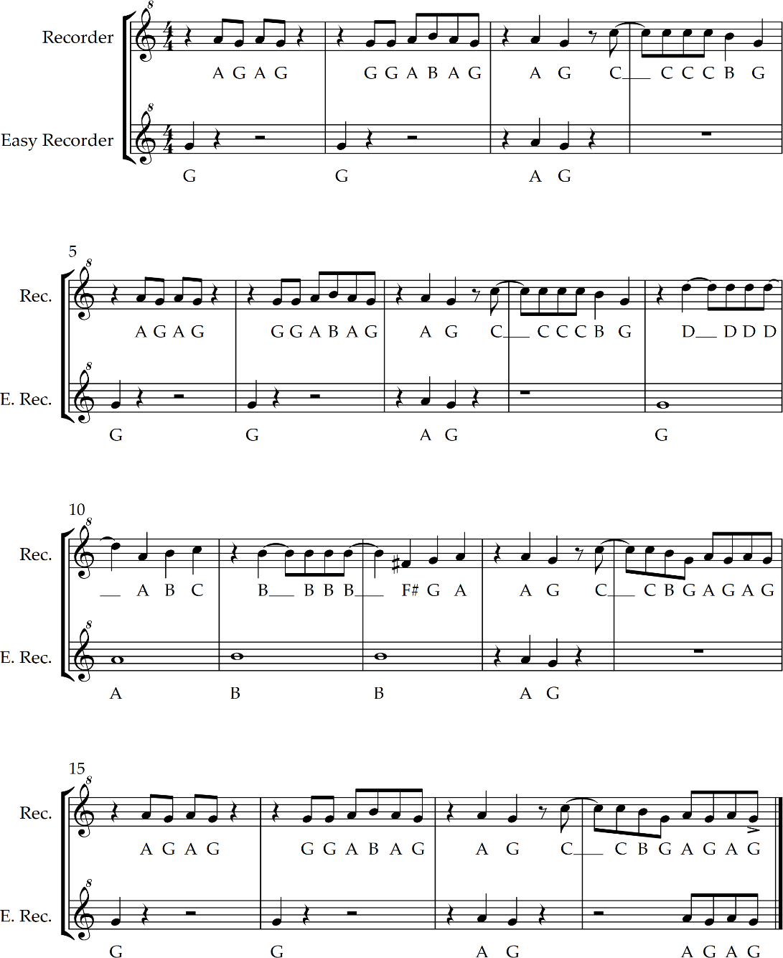
Mamma Mia Chorus with easy part

